Slide 1




Integrated Business Operations Platform
(IBOP)
Project Guide-Dr. Anushree Deshmukh
External Company :- Shrinath Enterprises
Student:-Mann dutiya Roll no: 16010123192

Slide 2
Introduction
Many small and mid-scale businesses still rely on manual processes or disconnected software to manage operations such as sales, accounting, HR, and inventory, leading to inefficiencies and data silos.
In real-world business environments, lack of integration results in delayed decision-making, reduced operational visibility, and increased chances of human error.
This project, Integrated Business Operations Platform (IBOP), is being developed in collaboration with a real business (Shrinath Enterprises) to address these challenges in a practical setting.
The system focuses on building a centralized, real-time platform that integrates multiple business functions into a single interface, improving coordination and efficiency.
It provides live data tracking, role-based access, and streamlined workflows, enabling better control over daily operations and informed decision-making.

Slide 3
Literature Review
Research Paper Review | Identified Gaps | Citations
A literature review on ERP implementation: Methodologies, module, software, and policy(2024):- The paper conducts a literature review of 19 research papers on ERP implementation. It analyzes ERP systems based on implementation methodologies, software types (open-source vs closed-source), modules, and company size. Different ERP implementation approaches (SAP ASAP, Oracle OUM, Odoo method) are compared and discussed. | No experimental validation or real system No performance comparison between ERP systes Does not evaluate which methodology is best Lacks user experience / usability analysis No intelligent/automated ERP system (no AI/ML) | A literature review on ERP implementation: Methodologies, module, software, and policy  Muhammad Faisal Ibrahim ; Yogantara Setya Dharmawan; Ngatini; M. Ilham Mustofa; Dana Marsetiya Utama
ERP ODOO IMPLEMENTATION IN SMALL RETAILERS:-The study uses an ERP implementation approach with Business Process Re-engineering (BPR). It analyzes existing business processes (As-Is) and redesigns them into ERP-based processes (To-Be). A Fit/Gap analysis is used to compare manual and ERP-based processes.Implementation is carried out using Odoo ERP across modules like accounting, inventory, purchase, and POS. | No comparison with other ERP systems No security or data privacy discussion No real-time analytics or decision support No reliable analytics dashborad | ERP ODOO IMPLEMENTATION IN SMALL RETAILERS Ary Arvianto, Zainal Fanani Rosyada, Singgih Saptadi, Wiwik Budiawan and Yasa Ewa Demilda Diponegoro University, Industrial Engineering Department, Semarang, Indonesi

Slide 4
Literature Review
Research Paper Review | Identified Gaps | Citations
ERP SYSTEMS ARCHITECTURE FOR THE MODERN AGE: A REVIEW OF THE STATE OF THE ART TECHNOLOGIES:-This paper follows a systematic literature review approach, analyzing multiple ERP architecture models and technologies from academic and industrial sources. It categorizes ERP architectures into different styles and evaluates their characteristics, advantages, and limitations. | This paper does not give any real-world testing or performance comparison and it also lacks in giving optimization techniques | ERP SYSTEMS ARCHITECTURE FOR THE MODERN AGE: A REVIEW OF THE STATE OF THE ART TECHNOLOGIES Mohammad Amini Valashani1,* , Arnold Mashud Abukari2 1 Research Center, FANAP Co., Tehran, Iran; m.amini @fanap.ir 2 Computer Science Department, Tamale Technical University, Ghana.
Implementation of Odoo-Based ERP in The Case Study of Micro, Small and Medium Enterprises (MSME) :- The paper follows a structured ERP implementation approach using Odoo. It includes business need analysis, GAP analysis, system design using UML, module configuration, data migration, testing (Black Box & UTAUT), and deployment on cloud VPS. | Performance metrics were not used to track sales and other records of employees | Implementation of Odoo-Based ERP in The Case Study of Micro, Small and Medium Enterprises (MSME) “Woody Moody Jakarta” Syafitri Lutfia Zahra1 , Syaifudin2 , Teddy Siswanto3* Information System Study123, Faculty of Industrial Technology, University of Trisakti

Slide 5
Literature Review
Research Paper Review | Identified Gaps | Citations
Modular Architecture in .NET Enterprise Systems: Patterns, Practices, and Evolution toward Scalable Systems:- The paper analyzes modular architecture patterns in enterprise systems, including layered architecture, composite applications, domain-driven design (DDD), and service-oriented architecture (SOA). It studies how systems evolve from monolithic to modular structures. | This paper does not take consideration of the business workflow integration for the project and is only a theoretical paper with no real implementation | Modular Architecture in .NET Enterprise Systems: Patterns, Practices, and Evolution toward Scalable Systems Author: Hema Latha Boddupally Affiliation: Senior Application Lead
Open-source ERP software;-The paper provides a descriptive overview of various open-source ERP systems, comparing their features, scalability, and application areas. | This paper is practically just a listing of the existing tools and having a comprehensive view of them, there is no real implementation or proper analysis | Open-SourceERP. Scott Nesbitt Jason B

Slide 6
Literature Review
Research Paper Review | Identified Gaps | Citations
Design and Implementation of Inventory Management System for University :-The system is developed using a web-based architecture with PHP, SQL, and frontend technologies. It follows a structured design including system architecture, module division, and database design. The Waterfall model is used for development. | Only an Inventory management system not a integrated ERP System | Design and Implementation of Inventory Management System for University Santosh Soni, Pankaj Chandra, Akanksha Gupta, Deepak Kant Netam, Sushant Kumar, Kaushik Tiwary santoshsoni.77@gmail.com, pankaj2684@gmail.com, akanksha.me2011@gmail.com, deepaknetam@gmail.com, kumar01sushant@gmail.com, casgguit@gmail.com
Proprietary vs. Open-Source ERP: The Case of SAP and Odoo:-The paper performs a comparative analysis between proprietary ERP (SAP) and open-source ERP (Odoo) based on multiple factors such as cost, scalability, customization, and business suitability. | This study doesnt have a performance comparison of the ERP tools | Proprietary vs. Open-Source ERP: The Case of SAP and Odoo Ferenc Erdős Department of Informatics Széchenyi István University Győr, Hungary erdosf@sze.hu Barnabas Isoke Kasangaki Information Technology Section Kibaale District Local Government Kibaale, Uganda ekbarnabas26@gmail.com László Koloszár Alexandre Lamfalussy Faculty of Economics Institute of Business Studies University of Sopron Sopron, Hungary koloszar.laszlo@uni-sopron.hu

Slide 7
Literature Review
Research Paper Review | Identified Gaps | Citations
Small-Medium Business Enterprise Management Application:-The system is developed using a structured software development lifecycle including requirement analysis, system design, development, testing, and deployment. It uses a cloud-based three-tier architecture with cross-platform support. | Security concerns were not merasured with minimal analytics. | Small-Medium Business Enterprise Management Application Manish Andure, Shivam Khule, Aneri Lohakane, Prashik Damodar, Balaji Chaugule
Web – Based Intelligent Inventory Management System:-The system is developed using a web-based distributed architecture with a client-server model. It integrates an intelligent system using fuzzy logic to manage inventory across multiple stores and determine reorder levels. Algorithm Used:Fuzzy Logic (Mamdani Inference System) | Not beginner friendly and way too complex due to the use of Fuzzy logic with limited scalability proof. | Web – Based Intelligent Inventory Management System Madamidola O. A Department of Computer Science Federal University of Technology Akure Daramola O.A Department of Computer Science Federal University of Technology Akure Akintola K .G. Department of Computer Science Federal University of Technology Akure

Slide 8
Problem Statement
Businesses, especially small and medium enterprises, often rely on multiple disconnected systems to manage sales, inventory, finance, and human resources. This leads to data inconsistency, manual and inefficient workflows, making it difficult to obtain real-time insights and make informed decisions.
This project aims to develop an Integrated Business Operations Platform (IBOP) that consolidates key business functions such as CRM, sales, inventory, finance, and HR into a centralized web-based system, improving operational efficiency and decision-making.

Slide 9
Objectives
To design and develop a centralized platform that integrates multiple business operations including sales, inventory, finance, and human resources.
To automate key workflows such as order processing, inventory updates, invoicing, and reporting to reduce manual effort and errors.
To implement a role-based access system (Admin/User) for secure and controlled data management.
To provide real-time data tracking and automated report generation for better business insights and decision-making.
To build a scalable and customizable system that can adapt to different business requirements.
To implement secure JWT-based authentication and RBAC

Slide 10
Core Features of IBOP
Business Modules
Inventory Management
Sales Management
Invoice Generation
Expense Tracking
Employee Management
Financial Analytics
Authentication & Security
JWT Authentication
Role-Based Access Control (RBAC)
Protected API Routes
User Interface
Responsive Dashboard
Dynamic Analytics
Modular ERP-style Navigation
Technical Features
MERN Stack Architecture
MongoDB Atlas Integration
REST API Communication
Real-Time Workflow Synchronization

Slide 11
System Components
Core Logic & Feature
Frontend
React.js
Tailwind CSS
React Router
Backend
Node.js
Express.js
REST APIs
Database
MongoDB Atlas
Security
JWT Authentication
Middleware-Based Authorization
Architecture Features
Modular Design
Scalable Structure
Real-Time Data Synchronization
Project Advantages
Real-time business operation tracking
Simple and user-friendly interface
Designed for real-world deployment in a pharma distribution business

Slide 12
Technologies Used
Layer | Technology
Frontend | React.js, Tailwind CSS
Backend | Node.js, Express.js
Database | MongoDB Atlas
Authentication | JWT
Routing | React Router
API Testing | Postman
Version Control | GitHub

Slide 13
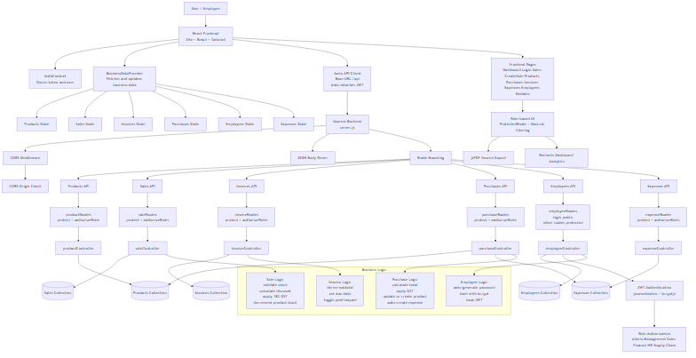
Architecture Diagram

Slide 14
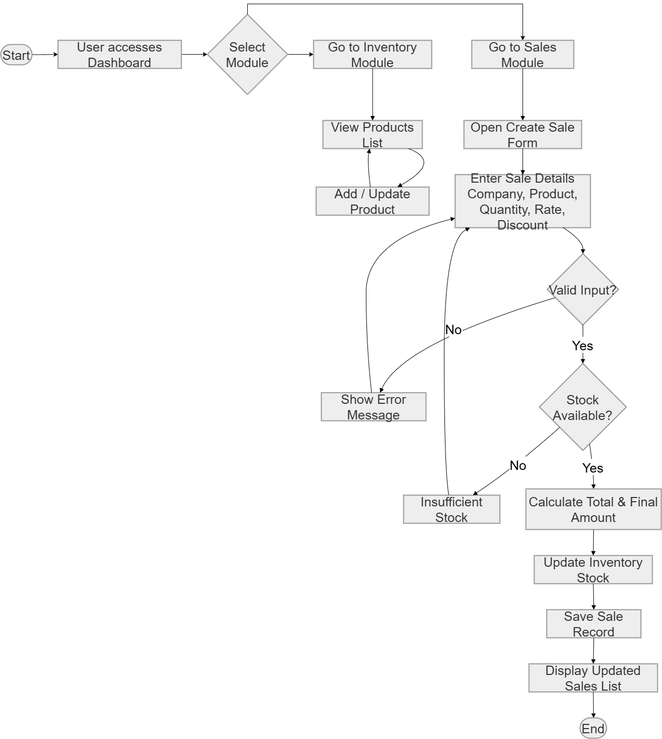
Operational Workflow of IBOP

Slide 15
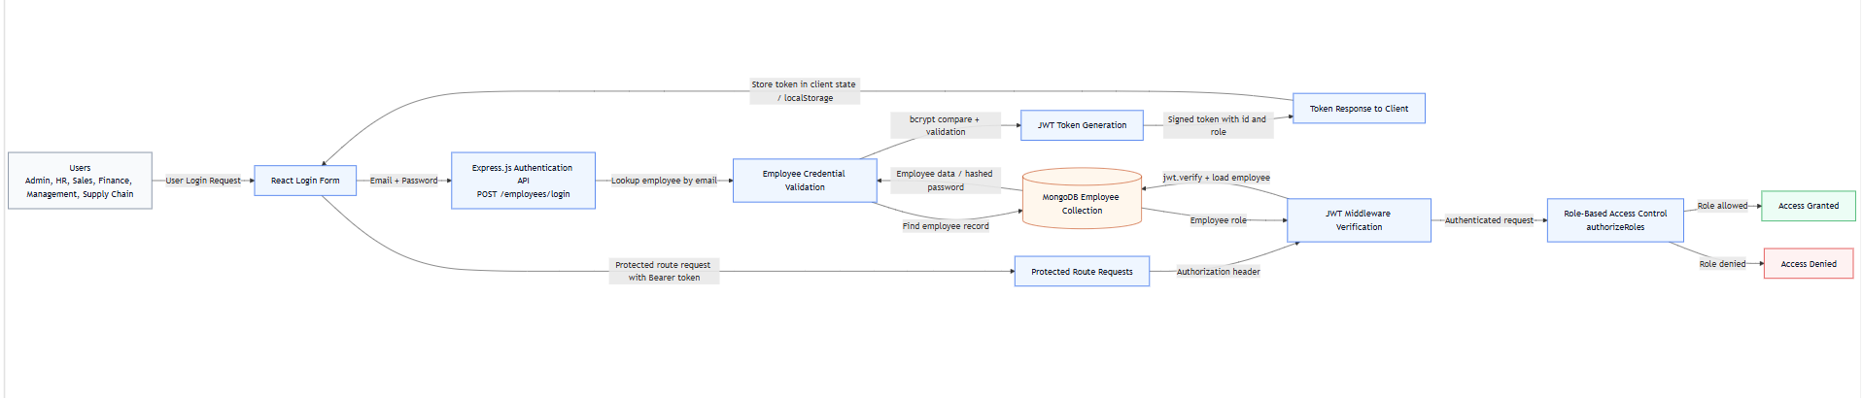
RBAC Authentication Workflow

Slide 16
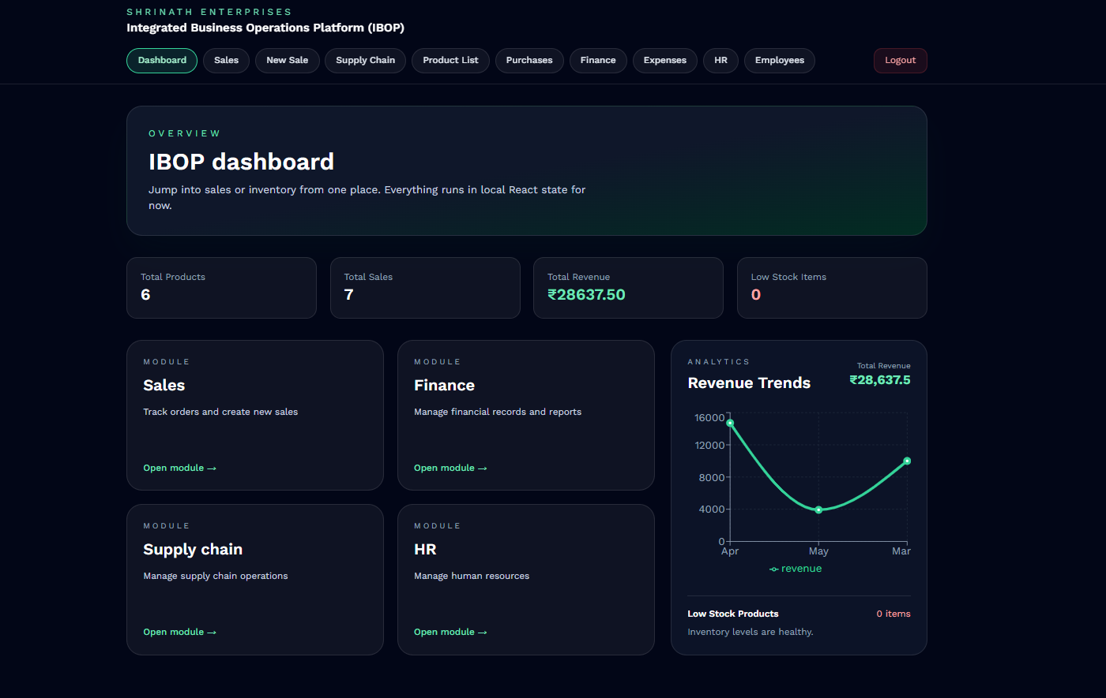
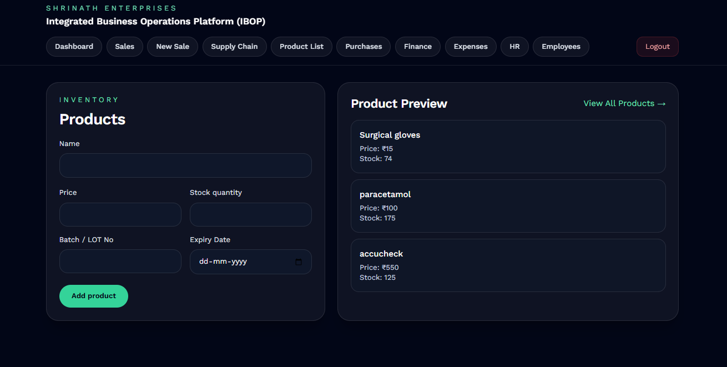
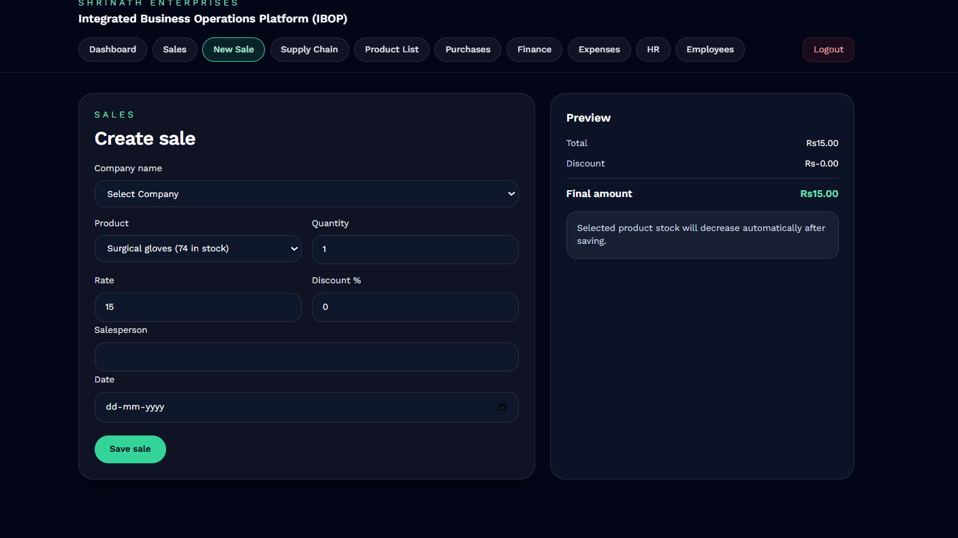
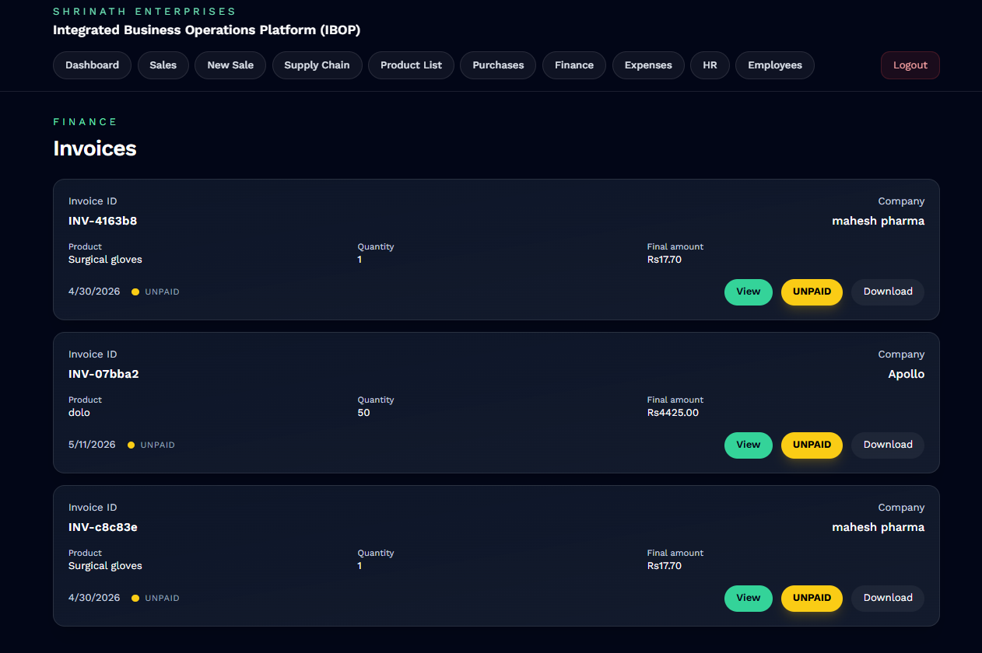
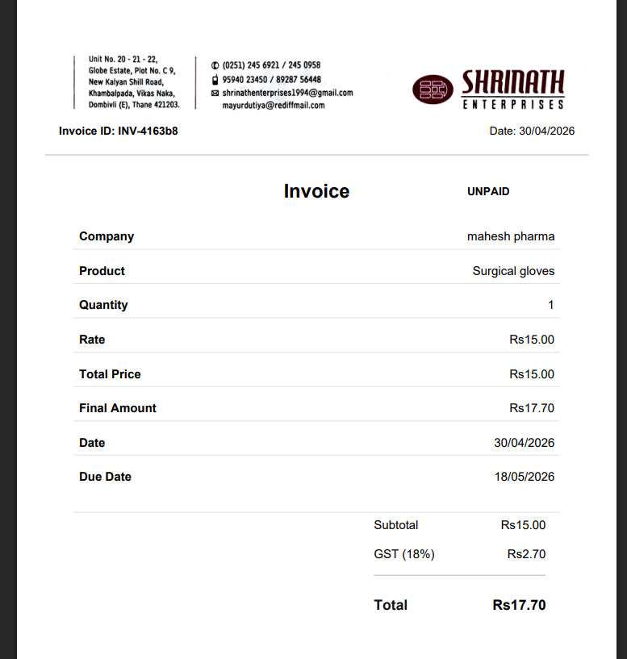
Implementation
Modular Dashboard
Inventory
Sales
Invoice

Slide 17
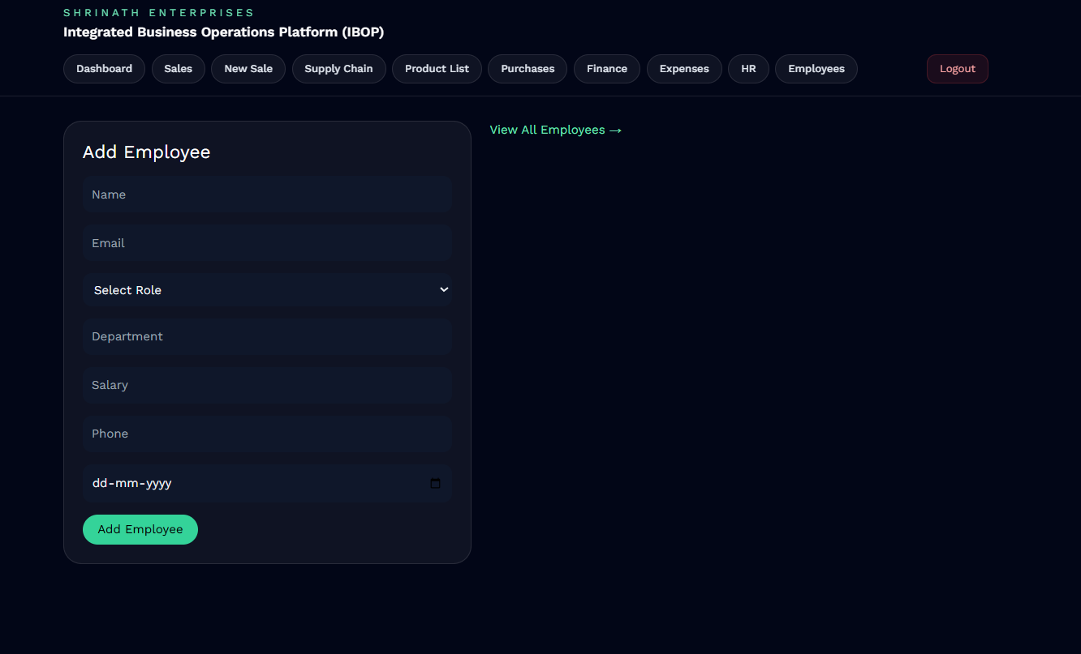
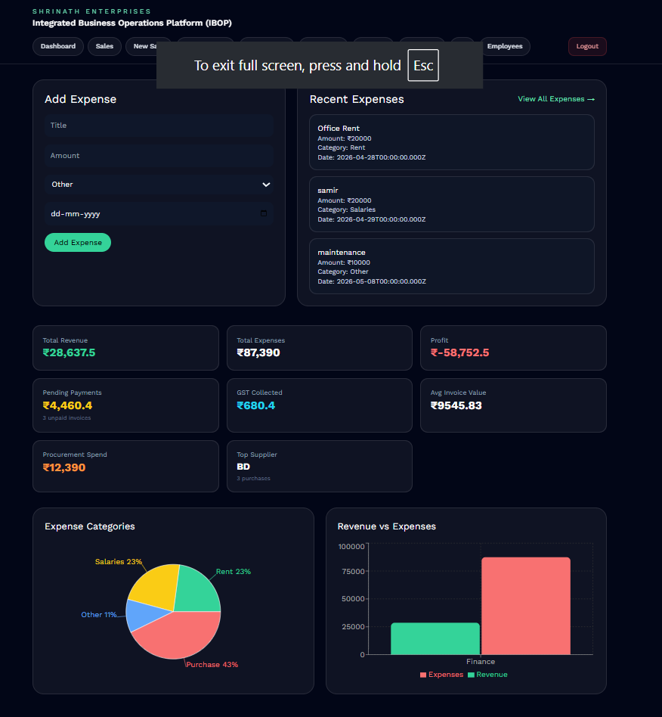
Implementation
Employee Management
Finance Analytics
Expense Management

Slide 18
Results Achieved
Developed a centralized ERP-style business management platform integrating multiple operational modules into a single system.
Successfully implemented Inventory Management, Sales Management, Invoice Generation, Expense Tracking, and Employee Management workflows.
Integrated frontend and backend modules using the MERN stack architecture (MongoDB, Express.js, React.js, Node.js).
Implemented JWT-based authentication and Role-Based Access Control (RBAC) for secure system accessibility.
Achieved real-time synchronization between sales transactions and inventory updates.
Automated invoice generation and financial record handling to reduce manual operational effort.
Developed responsive dashboards and analytics interfaces for improved operational monitoring.
Successfully deployed and tested the platform as an industry-oriented solution for Shrinath Enterprises.

Slide 19
Future Scope
AI-based business analytics and sales forecasting for intelligent operational insights.
Barcode and QR-code integration for faster inventory handling and product tracking.
Mobile application development for remote business management and monitoring.
Multi-branch business support with centralized cloud synchronization.
Advanced financial analytics and automated reporting systems.
Integration with online payment gateways and digital billing solutions.
Email and SMS notification system for invoices, stock alerts, and operational updates.
Cloud deployment optimization for large-scale enterprise scalability.
Advanced audit logging and cybersecurity monitoring mechanisms.
Integration of CRM and customer relationship management features in future versions.

Slide 20
Conclusion
Developed a centralized business operations platform integrating inventory, sales, finance, employee management, and analytics workflows.The platform implements a modular ERP-like structure, allowing different components to interact seamlessly while maintaining a clean and scalable architecture.
I developed core functionalities including product management, sales creation, automatic stock updates, and real-time calculations for transactions. The system ensures data consistency by linking sales directly with inventory, reducing manual intervention and minimizing errors.
The application was built using modern frontend technologies with a focus on simplicity, usability, and real-world applicability. Features such as centralized state management, role-based workflow design, and a modular dashboard demonstrate how business operations can be digitized effectively.

Slide 21
References
Literature review papers:
A literature review on ERP implementation: Methodologies, module, software, and policy-https://www.researchgate.net/publication/379348882_A_literature_review_on_ERP_implementation_Methodologies_module_software_and_policy
International Journal of Applied Science and Engineering Review- https://akjournals.com/view/journals/1848/1848-overview.xml
ERP SYSTEMS ARCHITECTURE FOR THE MODERN AGE: A REVIEW OF THE STATE OF THE ART TECHNOLOGIES- https://www.researchgate.net/publication/343450571_ERP_SYSTEMS_ARCHITECTURE_FOR_THE_MODERN_AGE_A_REVIEW_OF_THE_STATE_OF_THE_ART_TECHNOLOGIES
Implementation of Odoo-Based ERP in The Case Study of Micro, Small and Medium Enterprises (MSME) “Woody Moody Jakarta”https://www.researchgate.net/publication/374833941_Implementation_of_Odoo-Based_ERP_in_The_Case_Study_of_Micro_Small_and_Medium_EnterprisesMSME_Woody_Moody_Jakarta
Modular Architecture in .NET Enterprise Systems: Patterns, Practices, and Evolution toward Scalable Systemshttps://papers.ssrn.com/sol3/papers.cfm?abstract_id=6258779

Slide 22
References
Open-SourceERP.pdf https://www.researchgate.net/publication/394306023_Open-Source_ERP
Design and Implementation of Inventory Management System for Universityhttps://www.researchgate.net/publication/371989579_Design_and_Implementation_of_Inventory_Management_System_for_University
Proprietary vs. Open-Source ERP: The Case of SAP and Odoohttps://www.researchgate.net/publication/387763540_Proprietary_vs_Open-Source_ERP_The_Case_of_SAP_and_Odoo
Small-Medium Business Enterprise Management Applicationhttps://papers.ssrn.com/sol3/papers.cfm?abstract_id=5214661
Web – Based Intelligent Inventory Management Systemhttps://www.researchgate.net/publication/317276986_WEB_-_BASED_INTELLIGENT_INVENTORY_MANAGEMENT_SYSTEM

Slide 23
THANK YOU

